Slide 1
Medical Records
Office Management

Slide 2
Introduction
Medical Record- a permanent written account of the professional interaction and services rendered in a valid patient-client relationship.
Some of most important documents in veterinary medicine.
Medical record management is one of most important tasks.
Purpose is to proved an accurate history for the vet health team and the owner.

Slide 3
Types of Medical Records
May be paper or computerized (paperless).
  Pros and cons to each system.
    Inactive records must be kept for a certain length of time.
    Copy of any written communication with owner must be in the medical record (may be evidence).
    Should be checked regularly for completeness.
      The more information that is available the better.

Slide 4
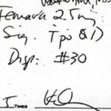
Legibility of Medical Records
Records must be legible and able to be read by anyone.
If legibility is a problem, then labels or stamps may be suggested for routine procedures.
Correction fluid cannot be used on medical record, release, or authorization form at any time.
If mistake is made, make one line strike through and initial.

Slide 5

Choosing a File System
Filing by owner’s last name.
Filing by client number.
Color code system.

Slide 6
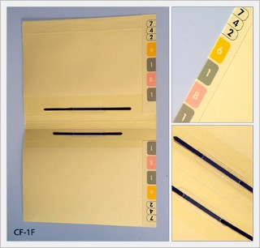
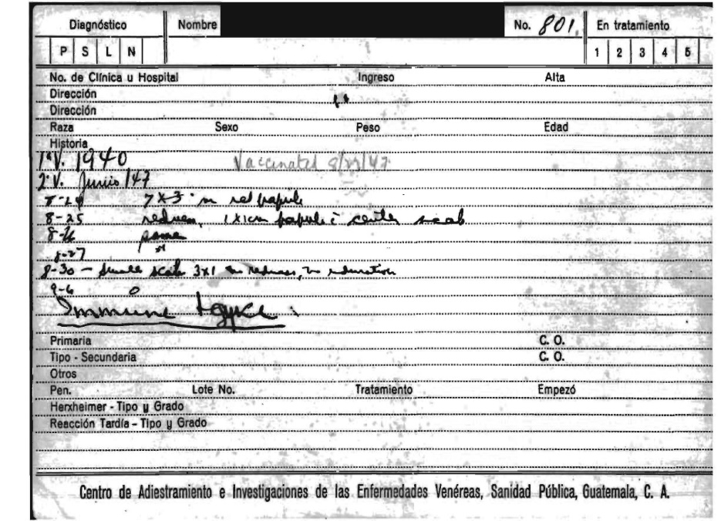
Paper Records
Full Paper Records
  8.5 x 11 inch paper and fastened into a file folder with a 2 hole fastener.
Index Card Records
  5 x 8 inch index cards
  Seem to be that team members write less on these records. May be considered incomplete or illegible.

Slide 7
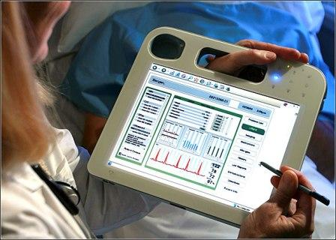
Computerized Medical Records
Filed in the computer by both client number and last name.
Can be accessed by any computer and has all records linked to the main patient file.
Must be secure, with access limited to authorized individuals only.
Must be backed up daily and monthly, preferably off-site.
Need back ups if computer become unavailable.

Slide 8

Medical Records Release
Are confidential and can only be released when the owner has given permission to do so.
Clients must sign a records release form which must be kept in the record (includes release to another veterinary clinic, boarding, grooming, or new owner).
Clients may request a copy of their medical records at any time.

Slide 9

Establishing a Medical Record
Each patient must have their own medical record.
Records must be easily able to be retrieved.
Medical records must be complete and well-organized (should follow SOAP format).
Records should be composed as legal documents that can be admissible in court if needed.
Legibility of records is a must!

Slide 10


Can have color coding to represent sex of patient.
Can have numbers on outside representing year which patient was last seen in order to purge records more readily.
Can have cautions written on in colors or highlighted on the actual chart.

Slide 11
What is included in a medical record?
Client/Patient Information sheet.
Previous Medical History.
Vaccination History.
The Primary Complaint.
Physical Examination.
Diagnosis and/or Possible Diagnosis.
Laboratory Reports.
Treatment
Prognosis.
Surgical Reports
Estimates and Consent Forms

Slide 12
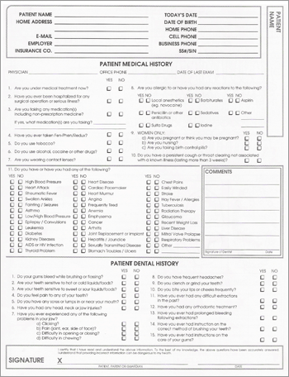
Taking A History
All information the owner has presented must be summarized in the medical record.
Very important component of not only a visit but medical records as a whole.

Slide 13
Problem Oriented Medical Record (POMR)
Most commonly in veterinary medical records follow SOAP format.
  S=Subjective
    Reason for office visit
  O=Objective
    Information gathered directly from the patient
  A=Assessment
    Any conclusions reached from the subjective and objective sections and includes a definitive diagnosis (rule ins (R/I) or rule outs (R/O))
  P=Plan
    Developed in according to assessment includes treatment, surgery, medication, etc.

Slide 14
Accurately Recording
Medication names, strengths, and route must be accurately written in the medical records.
  Example: 0.2 ml cefazolin IV (is this right or wrong?)

Slide 15
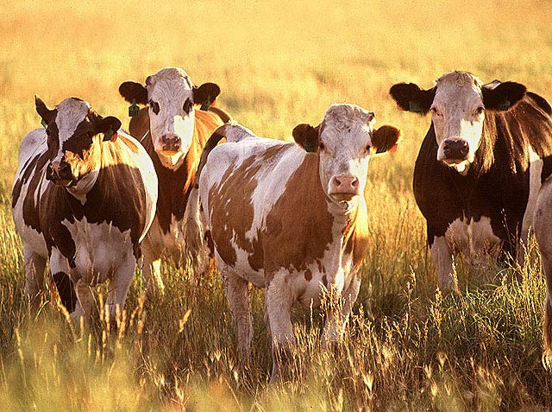
Herd Health Records
Large animal veterinarians cannot have individual records each food animal that they examine.
So record information for an entire herd, including medications and vaccinations on one record.
  Individual records may be kept if surgical procedures or special treatments are completed on one animal.

Slide 16

Purging Medical Records
Length of time a practice must keep an inactive medical record varies state to state.
Most require it to be kept for 3 years but should keep records on file from 3-7 years.
May have to arrange long term storage off site.
Purged records should be shredded.

Slide 17
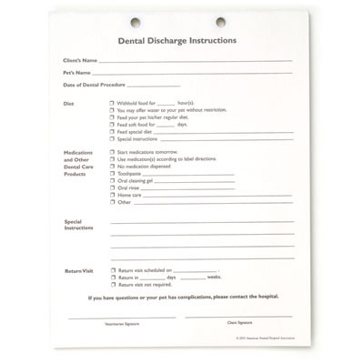
Client Discharge Instructions
Very important!
Should maybe have owner initial at bottom to confirm receipt of information.
Different types of information may be required for various patient discharges.

Slide 18
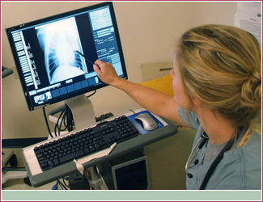
Radiographs
If paperless, then radiographs can be stored electronically.
Are property of the veterinary practice so log whenever radiographs are leaving the clinic.

